Slide 1
Weekly Progress Report
B100 APTIV Indospace Chakan
On 06/06/2020

Slide 2
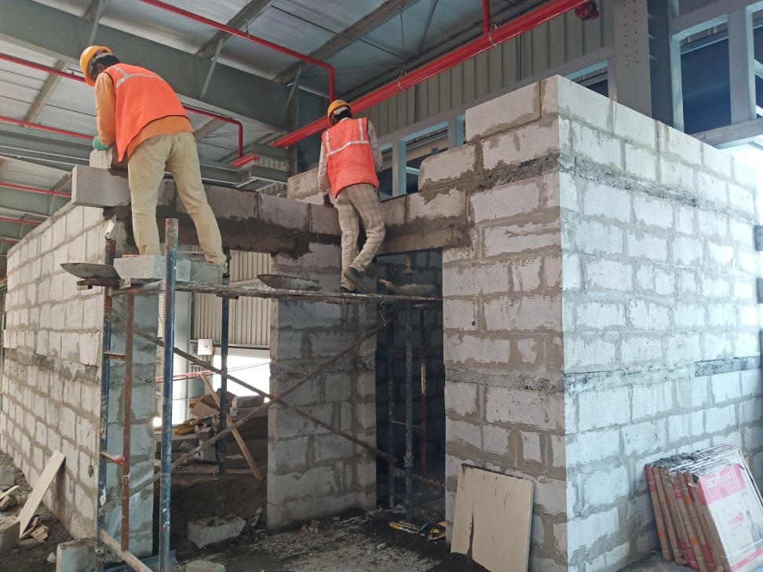
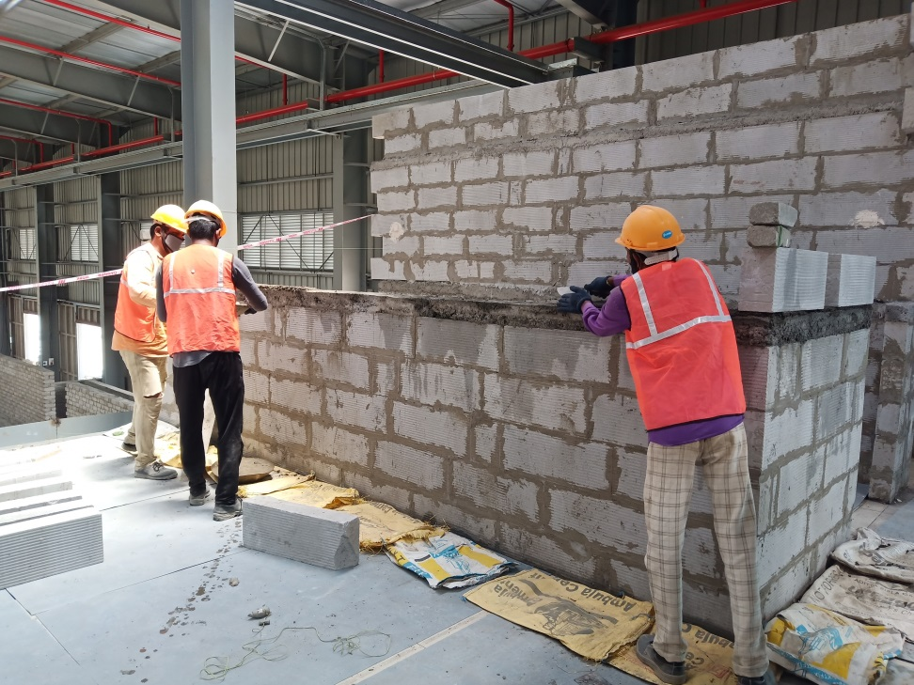
UPS Room & Server room block wall work 70% completed

Slide 3
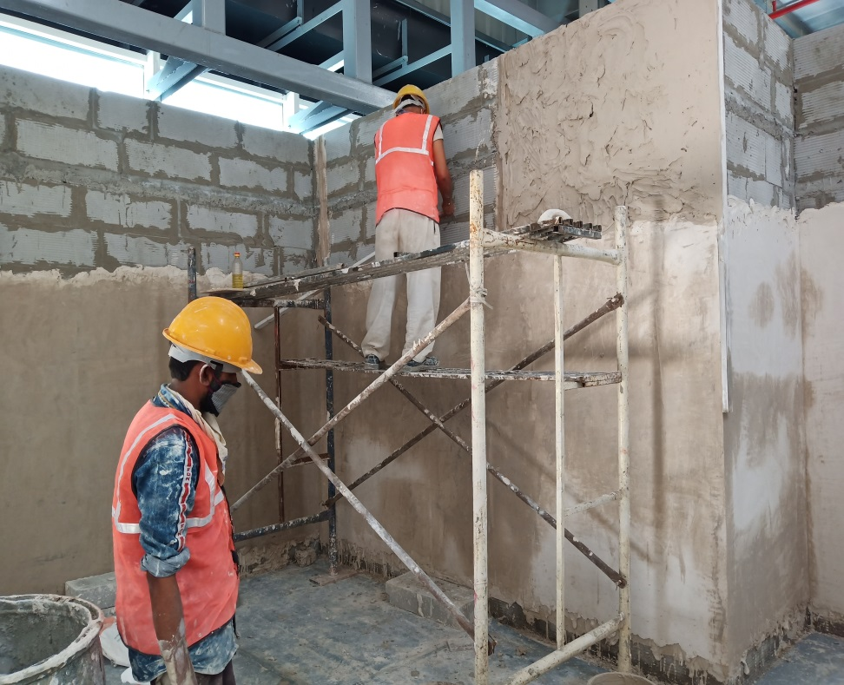
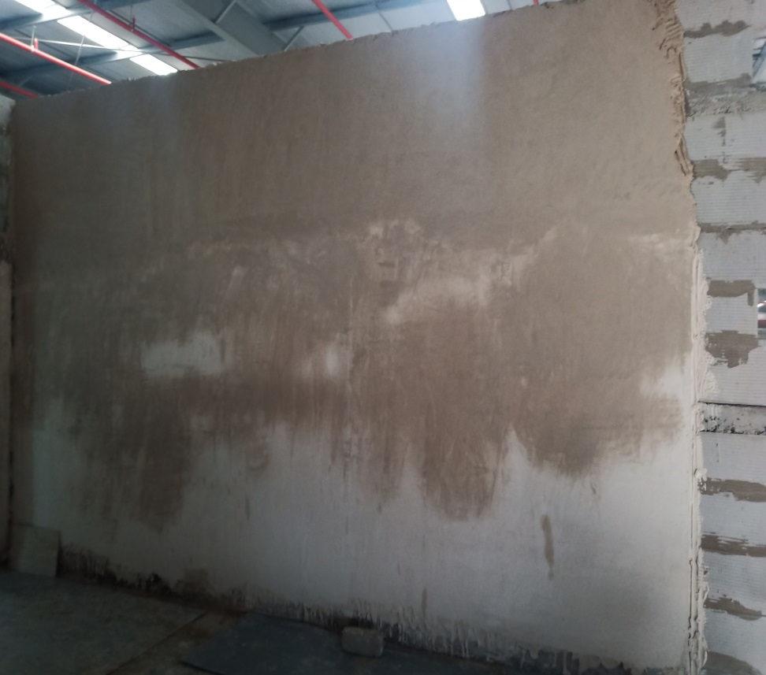
Server room POP punning work 75% completed

Slide 4
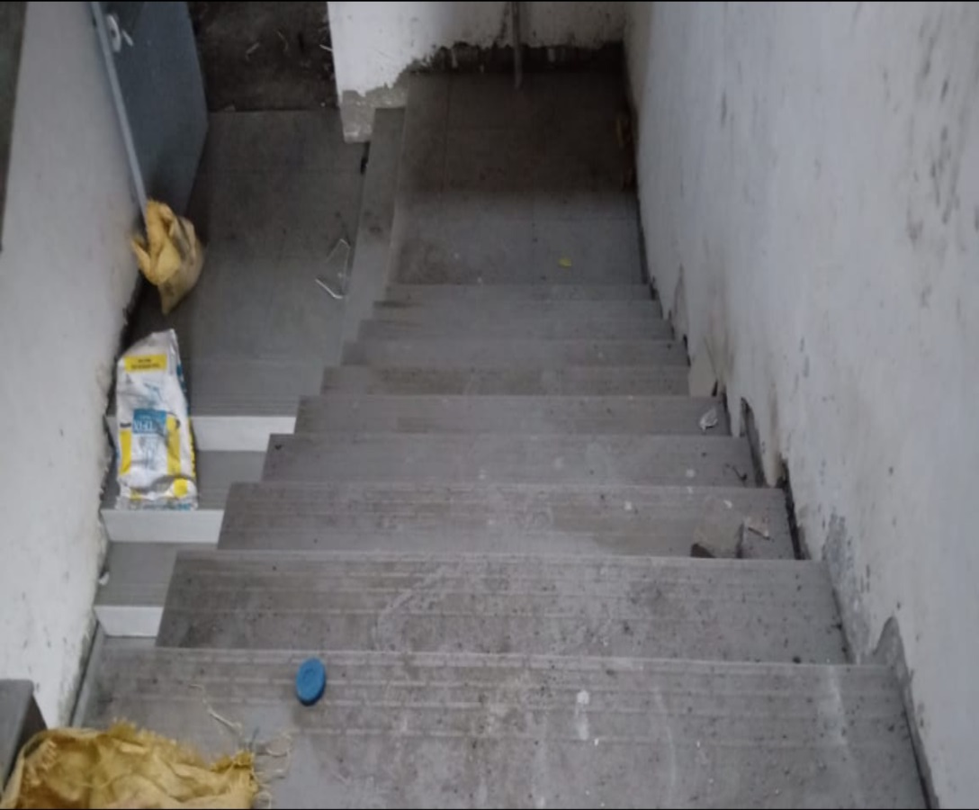
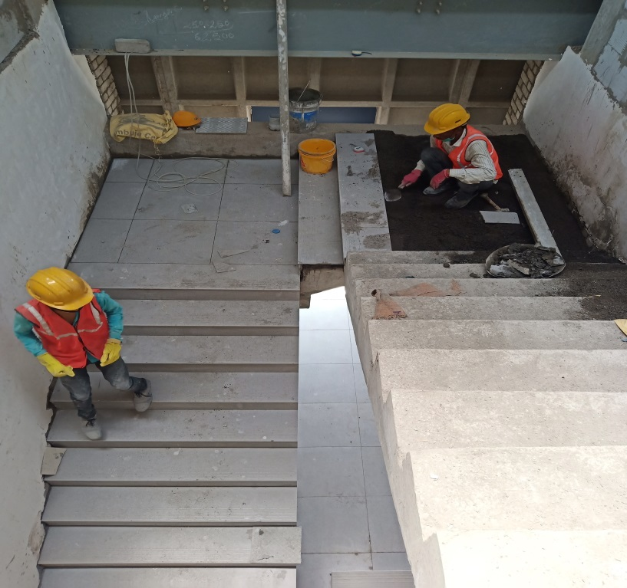
Staircase restiles fixing work 80% completed

Slide 5
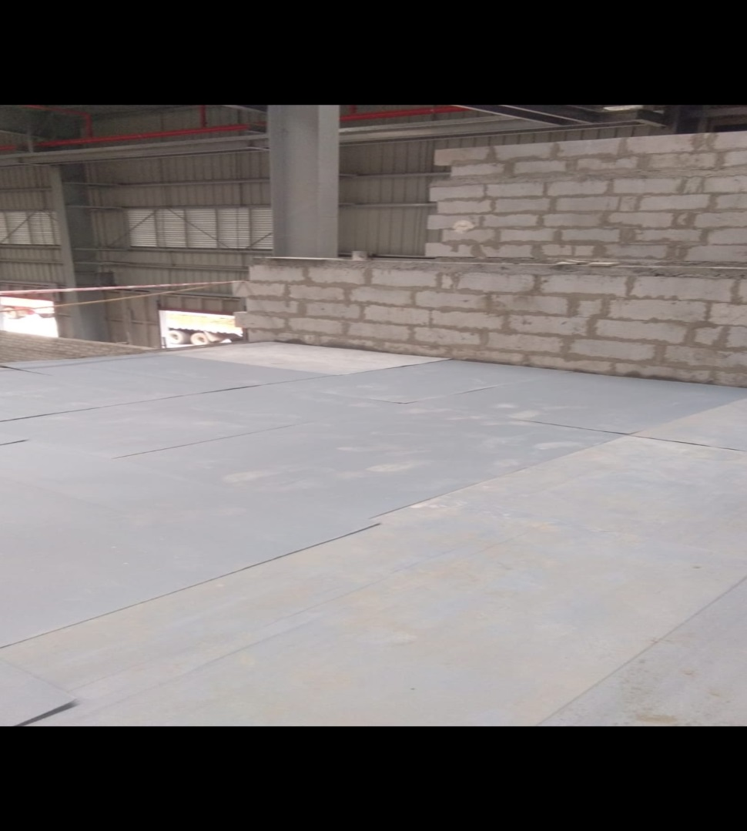
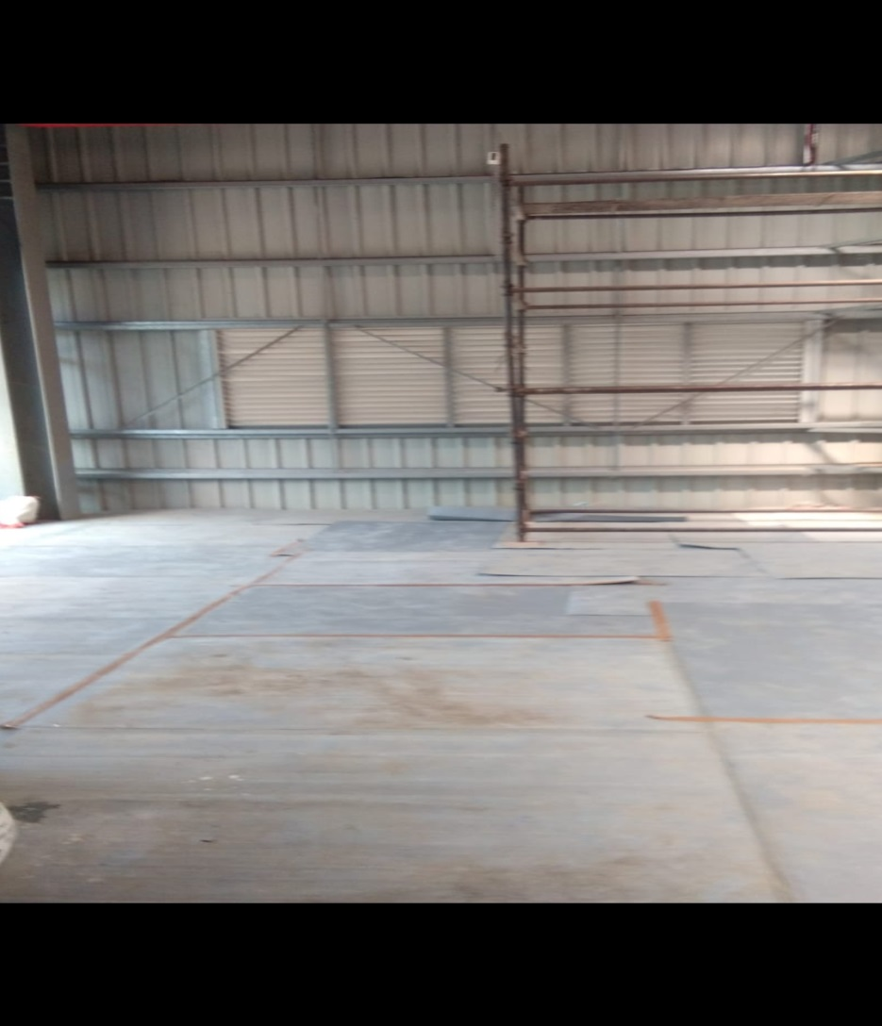
Mezzanine floor vetrified tiles fixing work 90% completed

Slide 6
Thank You
Shakti Interics

